Slide 1
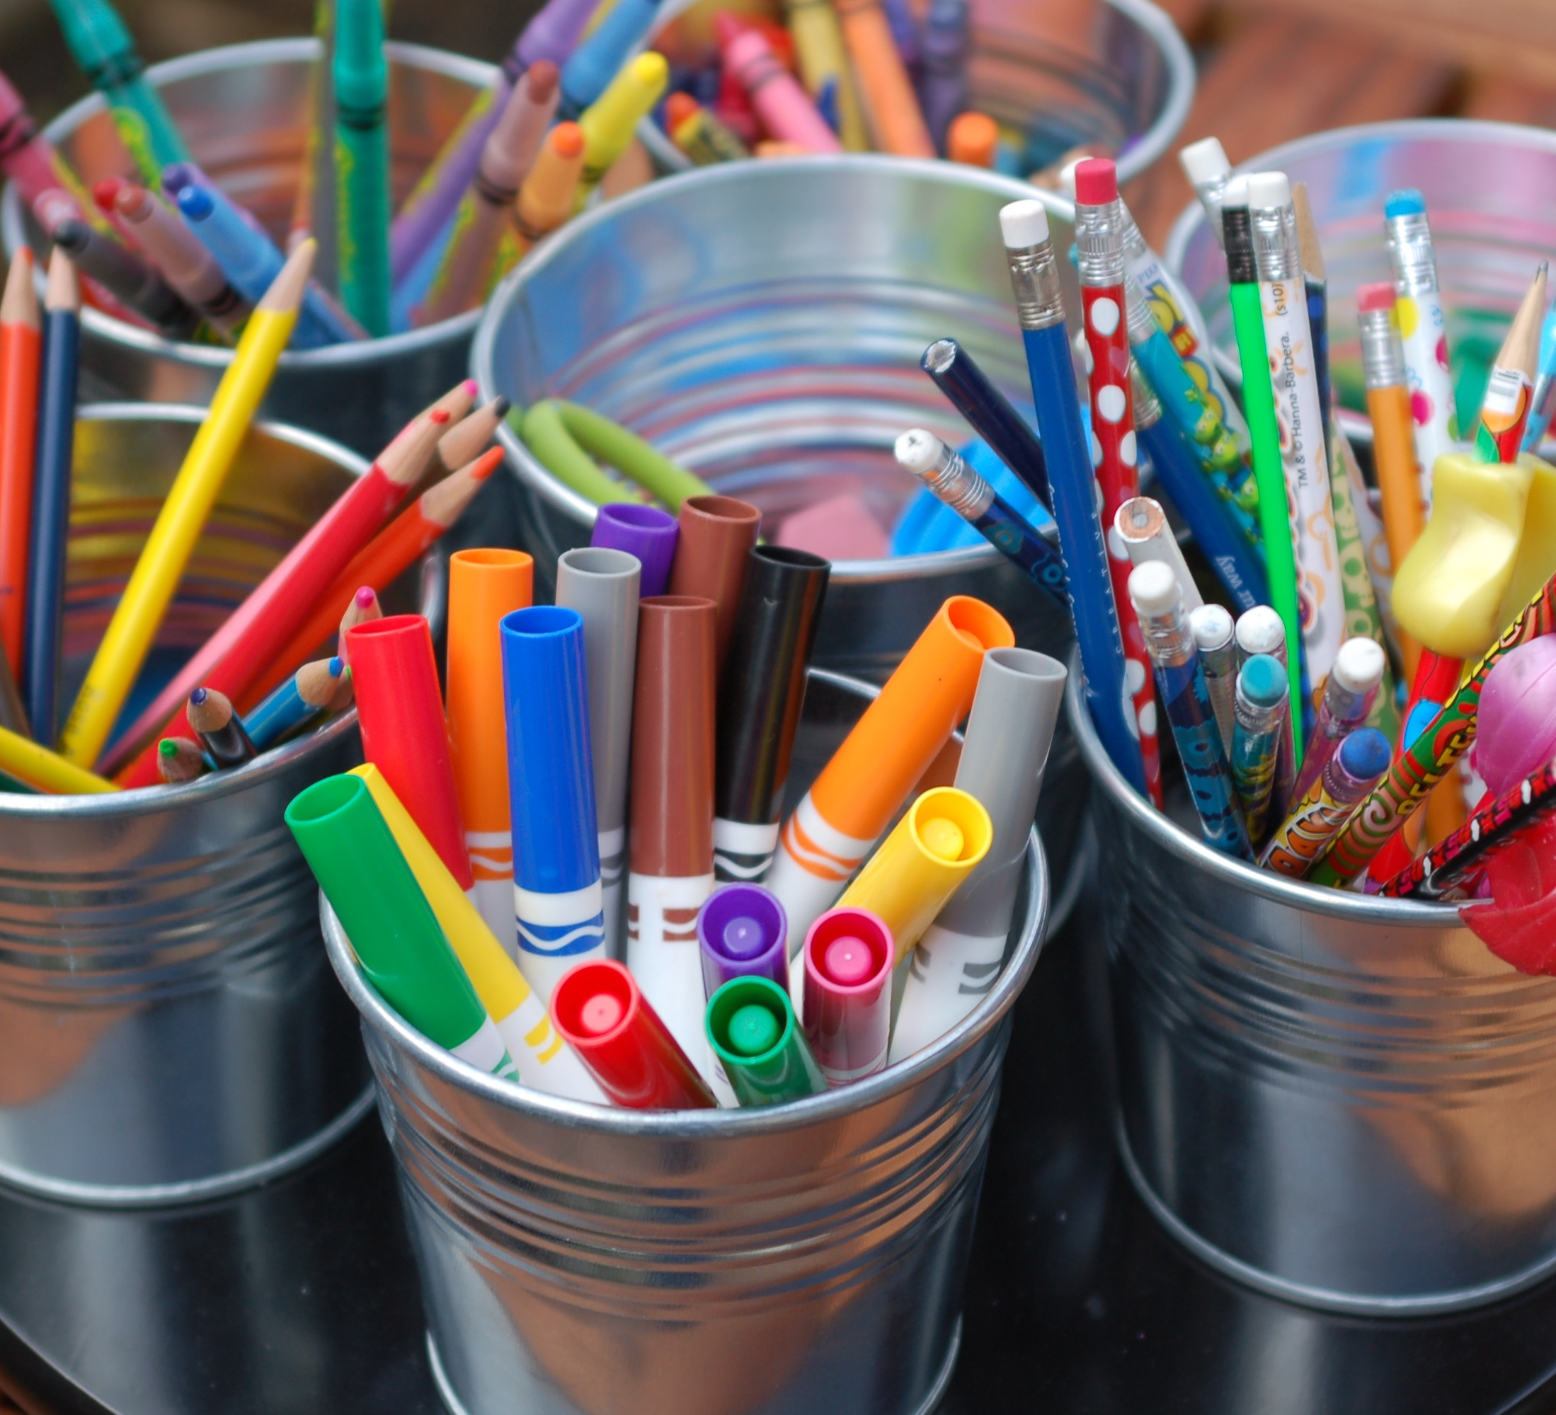
Welcome to Primary 3!
This Photo by Unknown author is licensed under CC BY

Slide 2
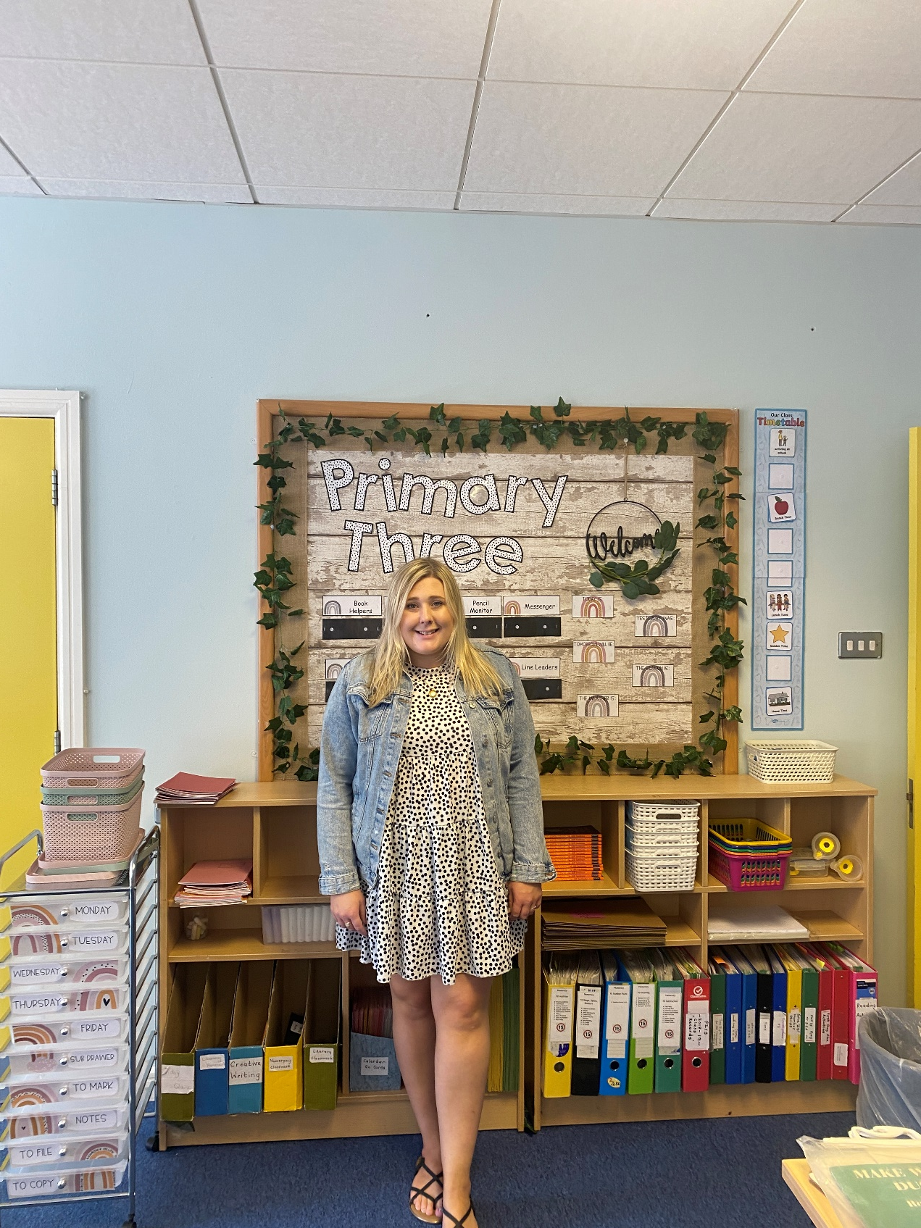
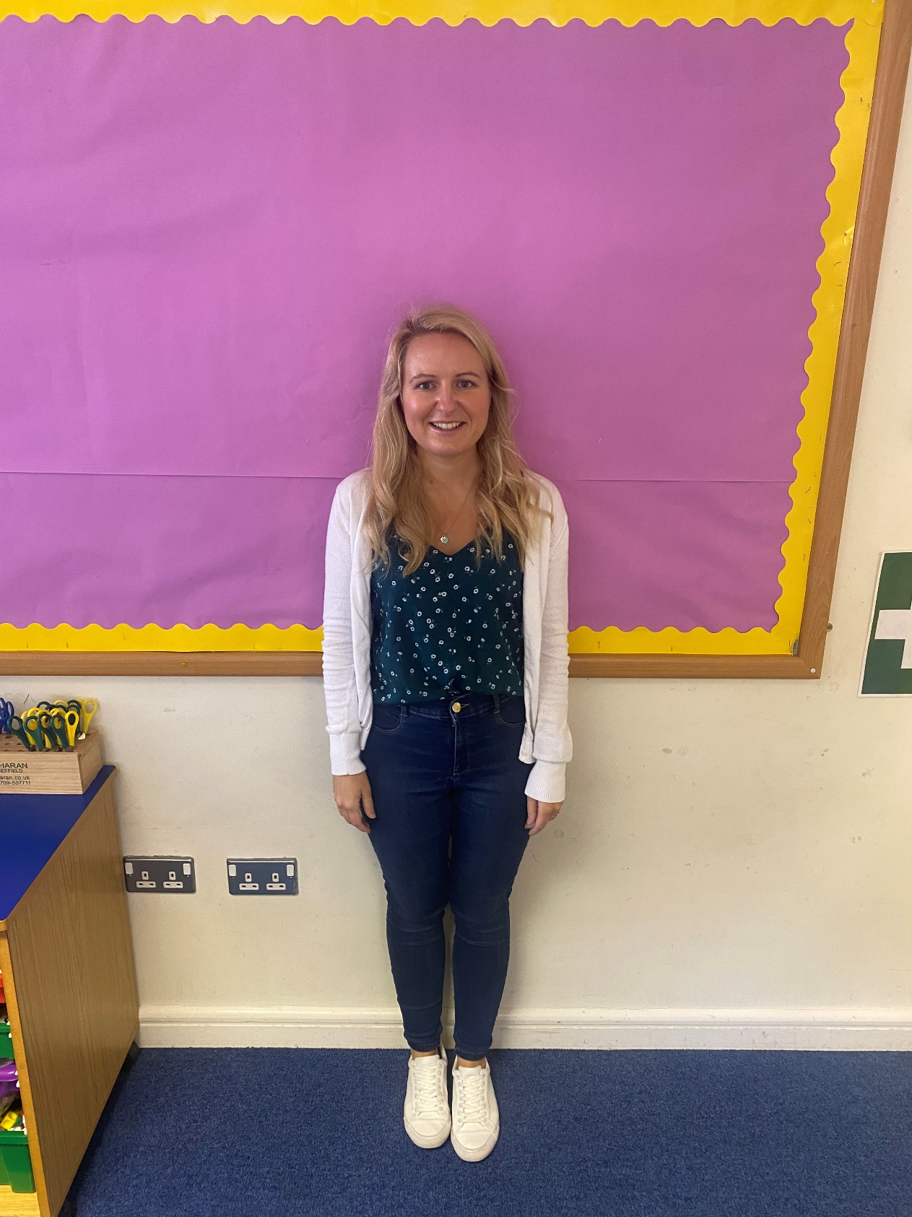
Welcome to Primary 3! We are going to be your teachers this year.
We are excited to meet everyone on the 25th August. This PowerPoint contains information about the P3 year and what to expect.
Miss McCluskie – P3M
Mrs Armstrong – P3A

Slide 3
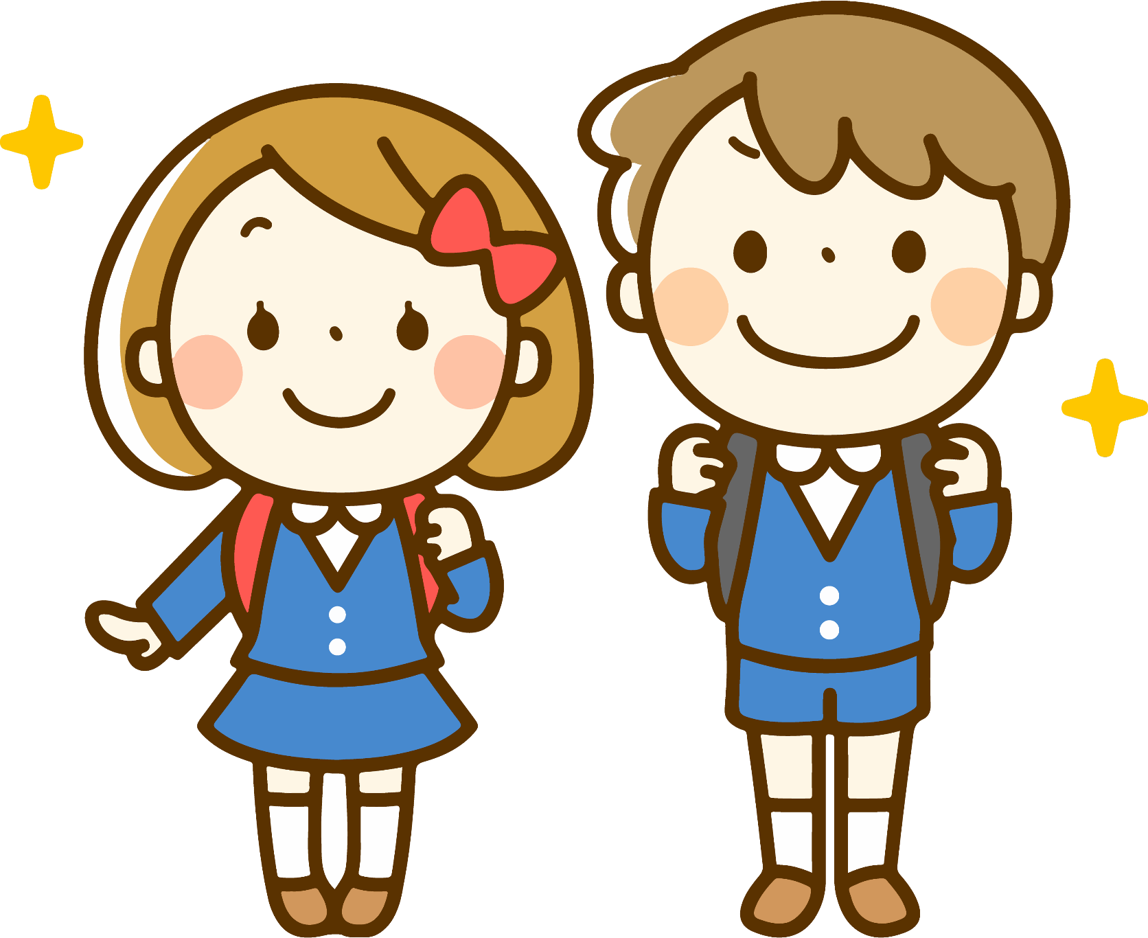
General Information:
Forms – Permission forms will all be completed online, apart from a blue data form which will need completed at home and a hard copy returned to your child’s class teacher.
If you are eligible for free school dinners you must complete the free school dinners form online. This refreshes each school year, so if your child had free school dinners last year, you will still need to complete the form for this year again. Forms can be found here: Apply for Free School Meals / Uniform Grants | Education Authority Northern Ireland (eani.org.uk).
Please put names/initials on all of your child’s belongings and uniform.

Slide 4
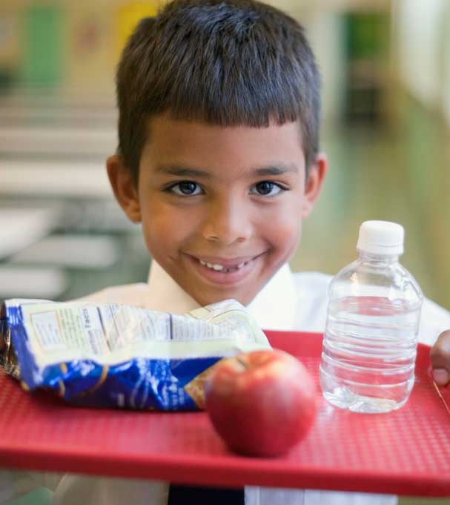
General Information Continued
Break/Lunch – all children will continue to eat in the classrooms again this year and this will be reviewed later in the year. Hot meals will be available for school dinners.
NO NUTS – we are a nut free school so please do not send anything containing nuts.
Please do not send your child into school with toys, unless it is for show and tell or it has been arranged with the class teacher.
This Photo by Unknown Author is licensed under CC BY-NC-ND

Slide 5
Drop off / Pick up
School will be open from 8.30am. P3 meet in the lower playground in the courtyard at Door 5. Your child’s class teacher will be outside to greet them. If the weather is bad, we will meet just inside the doors.
School work will begin at 9am so please ensure your child is in school before 9am.
Children will be picked up from the same area at home time.
25th – 31st August children will finish at 12 noon.
From the 1st September, P3 home time will be at 1.45pm.
This Photo by Unknown Author is licensed under CC BY-NC-ND

Slide 6
Homework Spellings & Tables will begin w/c Tue 31st August. Written homework will begin w/c Monday 6th September.
Monday : Spellings & Tables and Mathletics Online
Tuesday : Spellings & Tables and a written Literacy/Topic homework
Wednesday: Spellings & Tables and Reading night
Thursday: Revise spellings & tables for the Friday Test
Spellings & Tables sheets for the month will be sent home at the beginning of each month. Each Friday we will have a Friday Test where we test the children on that weeks spellings and mental maths they have learnt at home. These will be linked to what we are doing in class.
The written literacy/topic homework each week will also linked to what we are doing in class to revise concepts. Written homework's will be sent home in a homework folder on a Friday for the following week and we ask that these are returned on the Wednesday. This allows for some flexibility if a Tuesday night does not suit your family for a written homework. Any written homework's not returned before Thursday may not be marked due to turnaround time.
Friday Tests will be marked and sent home for parents to see. Please return these to school on the Monday.
Reading- we will be able to send reading books home this year and your child will bring home a reading book on a Friday to be read at home for the following week and returned on following Friday with their spellings and tables books. We recommend reading for a short time each night, but we know this may not always be possible so we encourage you to read with your child frequently when you can.
We will be using Bug Club again this year and we have set homework time aside on a Wednesday evening for Bug Club reading.

Slide 7
Spellings, Tables & Friday Test
Children should write out Monday, Tuesday and Wednesdays spellings into their spelling book using the look, cover, write method. Thursday night should be spent revising the week’s spellings for a Friday Test.
Tables should be practiced by writing them out, but also learning them mentally for the Friday Test.
Spelling and tables books should be sent in on a Friday for the teacher to see and will be returned for the following week.

Slide 8
Reading
The main scheme we use is “Storyworlds”
We have colour bands for books and read widely to broaden vocabulary.
The children study each book by reading the text both aloud and silently.
We discuss the story, illustrations and any issues arising.
We return to the text and discuss grammar and usage.
Bug Club will also be using for a variety of online reading and phonics practice.

Slide 9
Reading – What can you do?
Encourage fluency and expression.
Word attack skills – context, phonics sounds, word beginnings/endings
Ask questions – make sure they have understood what they have read. Look to increase their vocabulary.
Join the library, read and share books at home.

Slide 10
Phonics and Spellings
Linguistic Phonics approach – 15 minute session every day.
Practise Phonics – initial sounds, blends, rhyming words, word endings etc.
Remember – spelling is not just about spelling tests. The children must be able to spell words in their daily writing.

Slide 11
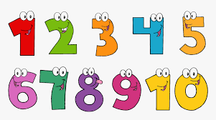
Numeracy In P3 children will….
Recognise numbers to 30, 50 and then 100
Use 100 square
Add and subtract up to 100 – horizontal and vertical
Read and use a calendar
Begin working with sets, counting in 2’s, 5’s and 10’s
Money – up to £1
Shape – 2D and 3D
Telling the time – analogue and digital
( hour, ½ hr and ¼ hour)
Measurement – length, weight and capacity.
Data Handling – a variety of graphs – Venn, Carroll, block, tally chart.

Slide 12
ICT In P3 children will…
Express: create and develop ideas using digital media
Exhibit: showing/ printing work
Evaluate: discuss their work
Explore: find and select information
Exchange: know that digital methods can be used to communicate

Slide 13
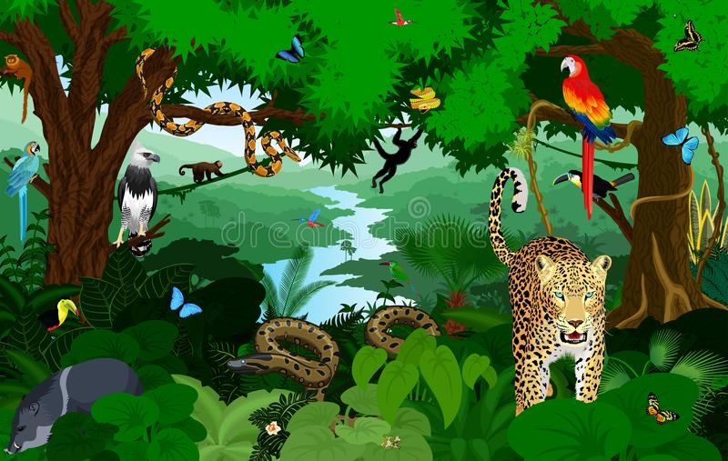
The World Around Us
This includes aspects of History, Geography and Science.
Literacy, Numeracy and ICT are often linked to Topics so that children can make connections with their learning.
Some of the topics we look at in P3 include; Ourselves, Cold Lands, Rainforests, House and Homes and Superhero's (people who help us).

Slide 14
Other learning areas
Music – loud/soft, high/low, slow/fast, listening, composing simple rhythms
Drama – role plays, puppets
PE – dance, team games, athletics, gymnastics
This is only a flavour of the work covered in Primary 3.
There is a lot of academic progress in Primary 3
School trips will hopefully be able to resume this year in the next term.

Slide 15
Consultations
Progress is monitored throughout the year along with assessments in October and May.
Individual appointments to discuss your child’s progress will be held in October and March.
A written report will be sent home in June.
Other parent communication:
Brief conversations are permissible in the mornings at the designated areas. If longer is required you can make an appointment for after school hours.
Dojo will remain our main form of communication this year. Therefore it will be updated regularly with information and you can message your child’s teacher via Dojo as well.

Slide 16
Thank you for taking the time to read this.
We hope it has answered any questions you may have but please don’t hesitate to contact us if you have any more queries or worries.
We look forward to working with you and your child this year and we are excited for the year ahead ☺
Miss R. McCluskie and Mrs D. Armstrong

